Slide 1

M4 - Video Analysis
Block 1. Assessment of Foreground Extraction and Optical Flow
Adrià Ciurana
Guim Perarnau
Pau Riba

Slide 2
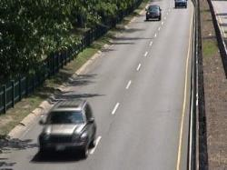

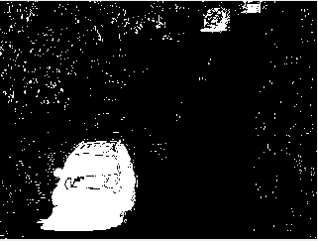
Task 1: calculate global metrics
Original image
Ground truth
Segmentation
RGB image
Grayscale image
Binary image
0 → static 50 → hard shadow
85 → outside ROI 70 → unknown motion
255 → motion
Ground-truth AND Segmentation = TP
Ground-truth AND ¬Segmentation = FP
¬Ground-truth AND ¬Segmentation = TN
¬Ground-truth AND Segmentation = FN
(¬ = negation)

Slide 3
Task 1: calculate global metrics
 | Test A | Test B
True Positive | 569355 | 312799
True Negative | 14323127 | 14564633
False Positive | 383289 | 141783
False Negative | 84229 | 340785
Precision | 59.76% | 68.81%
Recall | 87.11% | 47.85%
F1 Score | 70.89% | 56.45%

Slide 4
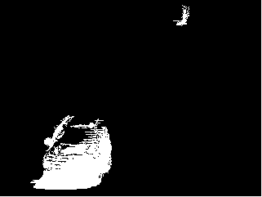
Task 2: precision VS recall
Ground truth
Test A (higher recall)
Test B (higher precision)
Segmentation
Test A segmentation has a higher recall because it misses less foreground pixels (true samples). However, it misclassifies background pixels (false samples) as foreground (FP) and, consequently, the precision lowers.
On the other hand, Test B has a higher precision because most of the positive pixels (TP+FP) are foreground (TP) at a cost of having foreground pixels incorrectly classified as background (FN), which lowers the recall.

Slide 5
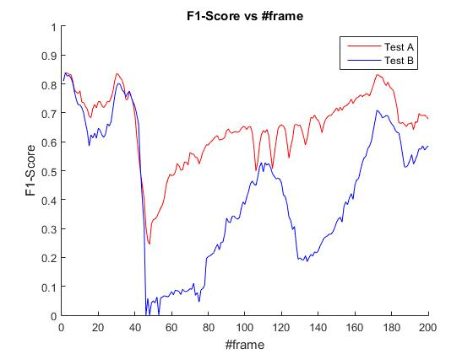
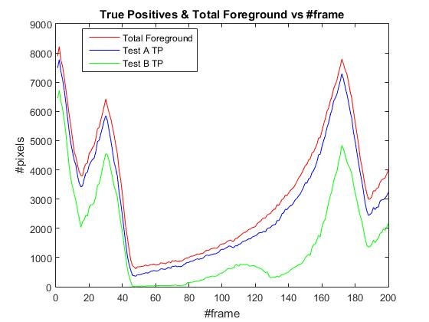
Task 3: frame by frame metrics
Huge F1 Score drop! Why?
If we look at the right figure, we can see that for frames 25 to 45 there are fewer foreground pixels, meaning that if the segmentation fails to detect a TP, the penalization on the F1 Score will be higher because it is proportional to the total number of foreground pixels. That’s the reason Test B segmentation drops to 0% F1 Score: it is focused on precision (rather than recall) which gives poor results when there are few foreground pixels.

Slide 6
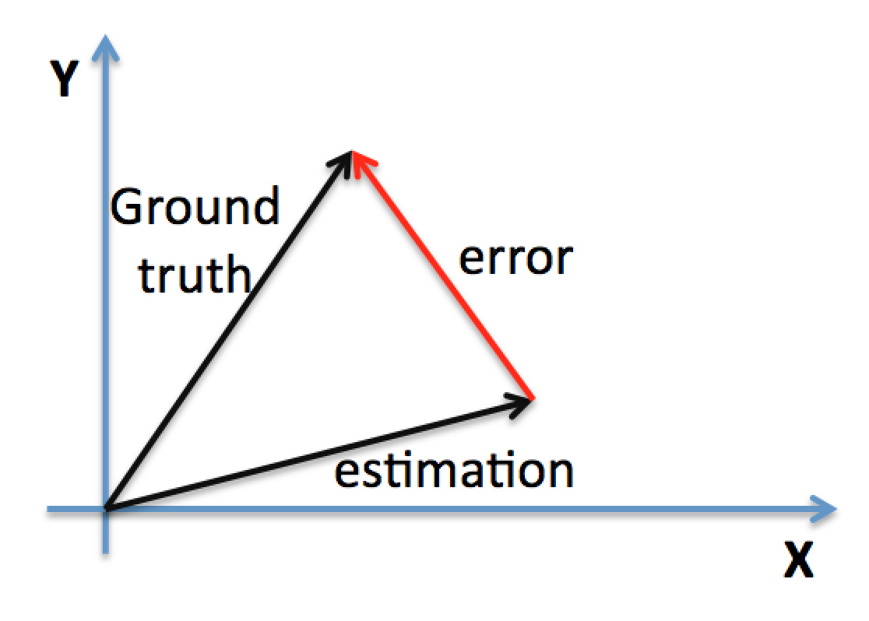
Task 4 & 5: Motion estimation metrics
Optical flow is stored in 3 channels:
Flow in u direction
Flow in v direction
Valid pixels
Let (u1, v1) be the ground truth vector
and (u2, v2) the estimation vector.
Two kinds of metrics:
Mean magnitude error, for all pixels in non-occluded areas. Therefore we have to sum the distance between vectors for each valid pixel and divide by the number of valid ones. For one pixel it is defined:
In our results: MMEN = 10.627078 (LKflow_000045_10)
MMEN = 2.750399 (LKflow_000157_10)

Slide 7

Task 4 & 5: Motion estimation metrics
Optical flow is stored in 3 channels:
Flow in u direction
Flow in v direction
Valid pixels
Let (u1, v1) be the ground truth vector
and (u2, v2) the estimation vector.
Two kinds of metrics:
Percentage of erroneous pixels, in non-occluded areas. Error pixel if its motion vector magnitude is greater than 3.
In our results: PEPN = 78.56% (LKflow_000045_10)
PEPN = 34.05% (LKflow_000157_10)

Slide 8
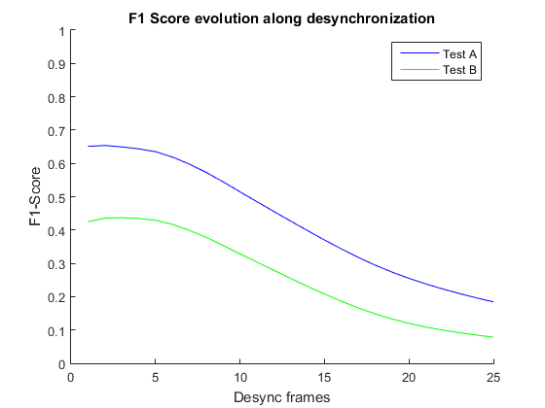
Task 6:
In this graphic, we can notice that adding a small offset (offset 1 to 5), the F1 Score is similar to not having any offset at all. In fact, for test B, it increases a little (offset 2-3) . Hence, it is possible that our results are desynchronized with respect the ground truth frames. This can be observed at the next slide.

Slide 9
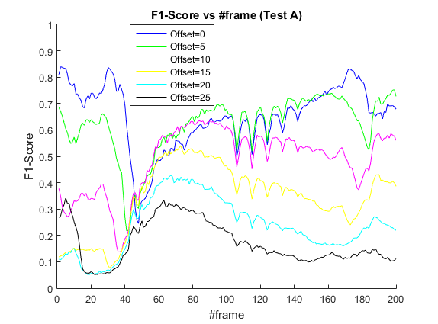
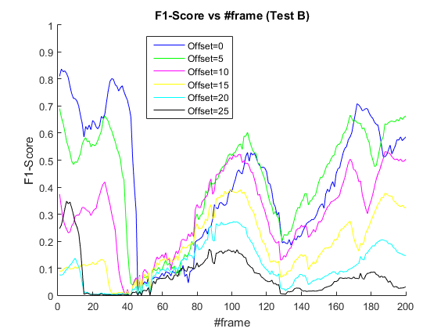
Task 6:
By computing the F1 Score frame by frame, we can notice that the F1 Score decreases at the beginning with an offset of 5. However, from frame 45 to 100 (110) in test A (test B) and from frame 120 to 160 in test B, this offset=5 gives a superior F1 Score than offset=0, meaning that, at that points, our data might be desynchronized.

Slide 10
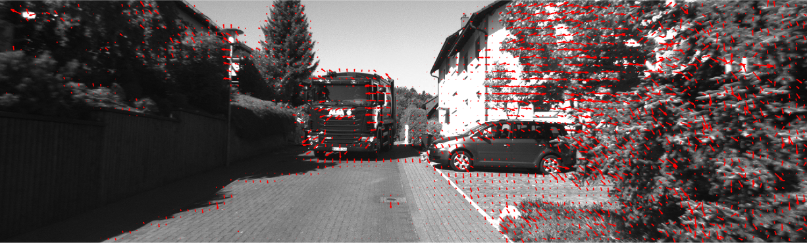
Task 7:
Steps to plot the motion vectors
Create a grid of the image size: positions (x,y) of every pixel.
Extract the motion vectors from the ground truth: components (u,v).
Subsample the image for a clean visualization:
Average convolution with a filter of NxN, where N is the subsampling factor.
Only show one of every N motion vectors
Call MATLAB quiver(x,y,u,v) function.

Slide 11
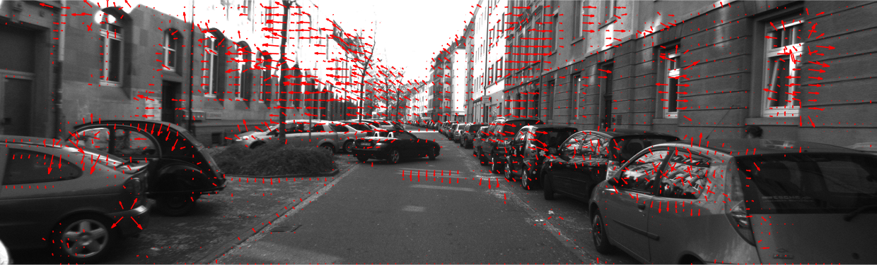
Task 7:
We have scaled up the motion vectors to simplify the visualization. Also, we can observe how most of the motion vectors indicate correctly the motion of the car, which is moving towards.

